Slide 1
Satellite Image Classification
Group Members:
Ijaz Ul Hassan 221980030
Muhammad Faraz 221980007
Hassan Rasheed 221980038
Haseeb Butt 221980004

Slide 2
Introduction
This Satellite image classification Project allowing you the automated categorization of land cover types from aerial imagery. This project utilizes deep learning to classify satellite images into five categories: Crop, Barren, Desert, Industrial, and Water. Unlike traditional classification methods, our approach leverages pretrained deep learning models for feature extraction and applies clustering and supervised learning to enhance classification performance.

Slide 3
Scope
This project evaluates the performance of a ResNet50-based classification model, using extracted deep features to predict the correct label for a given satellite image. Unlike attention-based encoder-decoder models, our approach relies on convolutional feature maps and K-Means clustering to improve classification accuracy.

Slide 4
Data Acquisition
Data Source: The dataset was generated by scraping images from Google Earth using Selenium. Total Scrapped images 75.
Dataset Format: Images were collected in JPG format and categorized based on location and visual characteristics.
Dataset Augmentation: Various augmentation techniques (flipping, rotation, noise addition) were applied to improve model robustness. After that the images are 375.

Slide 5
Data Preprocessing
Feature Extraction:
ResNet50 was used as a pretrained feature extractor.
Features were extracted from the last convolutional layer and stored as a (1 × 2048) vector per image.
Label Encoding:
The five categories were encoded into numerical labels.
The dataset was split into training (70%), validation (10%) and testing (20%).

Slide 6
Model Architecture
Instead of an attention-based RNN decoder, this project relies on ResNet50’s convolutional layers for feature extraction, followed by a fully connected classification layer:
Feature Extraction:
Input Size: (224 × 224 × 3) RGB images.
ResNet50 Backbone: Extracts feature representations from input images.

Slide 7
Model Architecture
K-Means Clustering:
Groups similar images into 5 clusters.
Used to validate separability of classes before classification.
Fully Connected Classifier:
Takes extracted feature vectors as input.
Uses Cross-Entropy Loss and Softmax Activation to classify images.
Optimized using Adam Optimizer.

Slide 8
Traning Pipeline
Feature vectors were extracted from all images and stored in .npy format.
The ResNet50 classifier was fine-tuned on the traning set.
Hyperparameter tuning was performed to select the best learning rate.
Accuracy and loss were tracked throughout training.

Slide 9
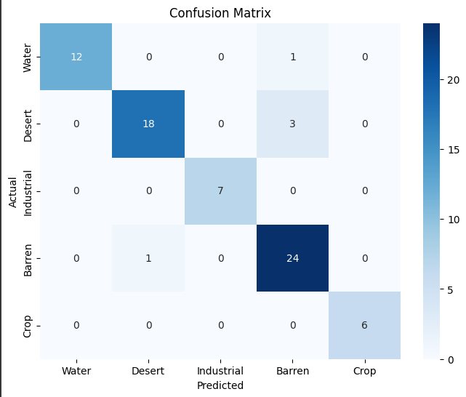
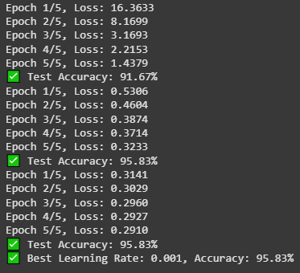
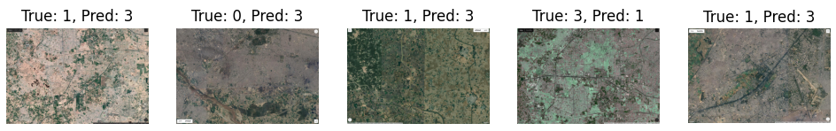
Results
Model trained for 10 epochs achieved classification accuracy of 95%.
Confusion matrix analysis showed that most misclassifications occurred between Desert and barren categories due to visual similarities.
Clustering analysis confirmed that feature representations were meaningful and distinguishable.

Slide 10
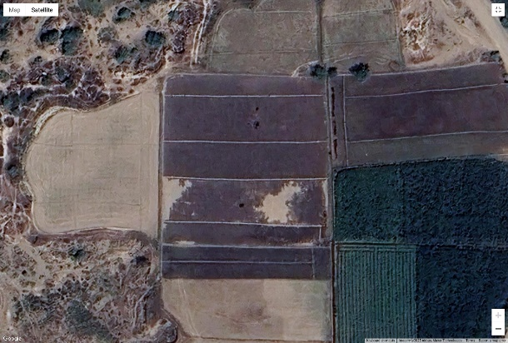
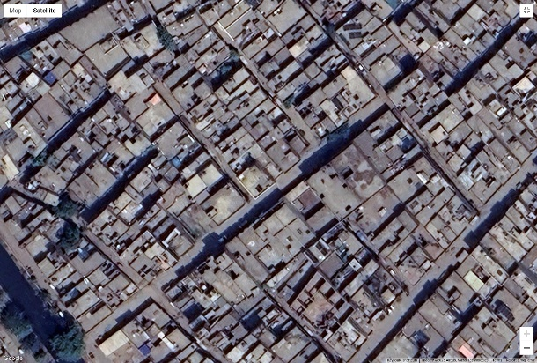
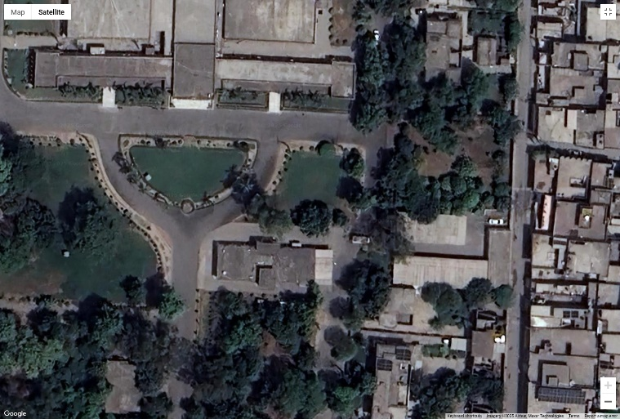
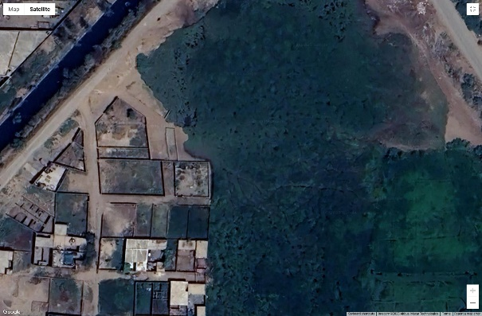
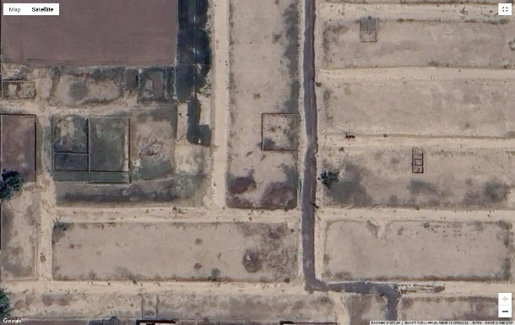
Example
Lahore images:

Slide 11
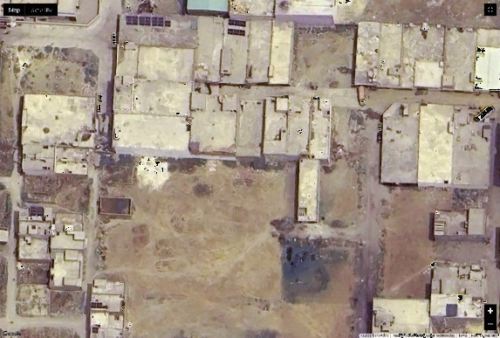
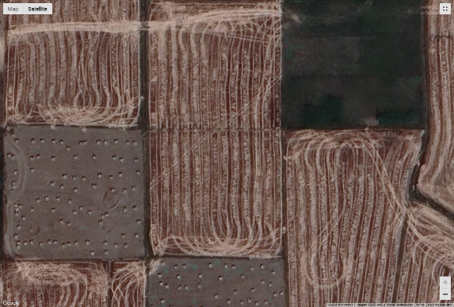
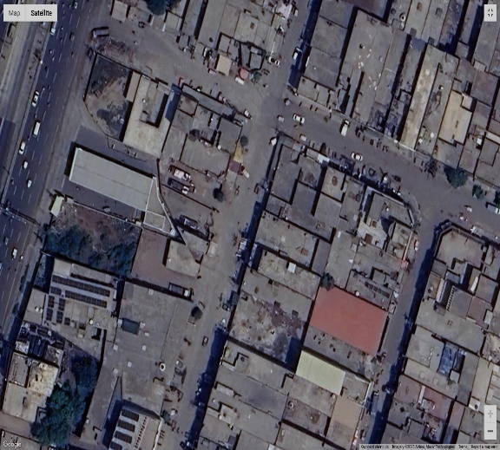
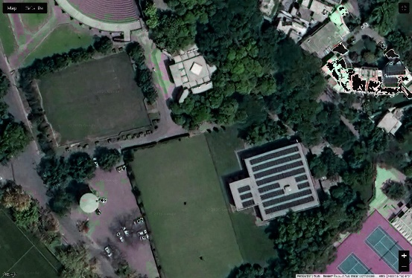
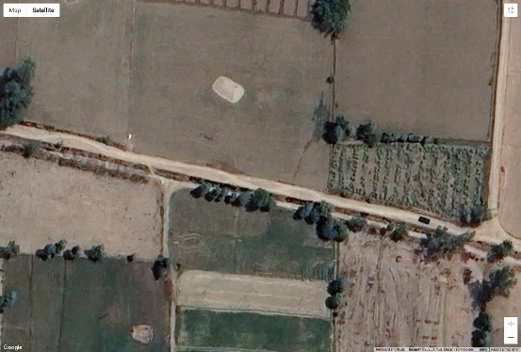
Example
Augmented images:

Slide 12
Conclusions
Using ResNet50 for feature extraction significantly improved classification performance compared to traditional methods.
K-Means clustering helped validate class separability before training the classifier.
Future improvements could include:
Experimenting with EfficientNet or Vision Transformers for feature extraction.
Fine-tuning the pretrained model on satellite-specific datasets.
Deploying the model as a real-time classification API.

Slide 13
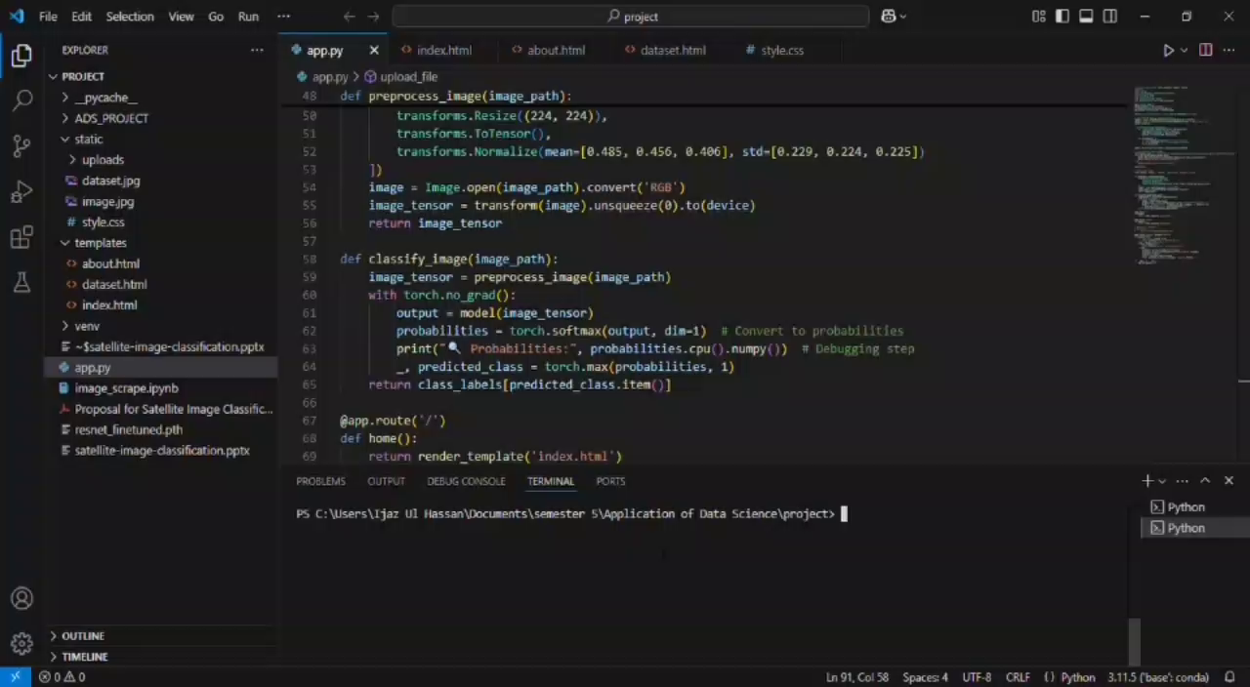
App Video

Slide 14


